Slide 1




Spatial and Temporal Tracking of
Ocean Wave Systems
André van der Westhuysen
(with thanks to Jeff Hanson and Eve-Marie Devaliere)
The WAVEWATCH III Team + friends
Marine Modeling and Analysis Branch
NOAA / NWS / NCEP / EMC
NCEP.list.WAVEWATCH@NOAA.gov
NCEP.list.waves@NOAA.gov

Slide 2
Outline
Covered in this lecture:
  Partitioning and tracking algorithms
  Criteria for combining and tracking sytems
  Idealized cases
  Field cases:
    North Pacific
    Hawaiian Islands
    U.S. West Coast
    WFO Los Angeles
  Conclusions and future work

Slide 3
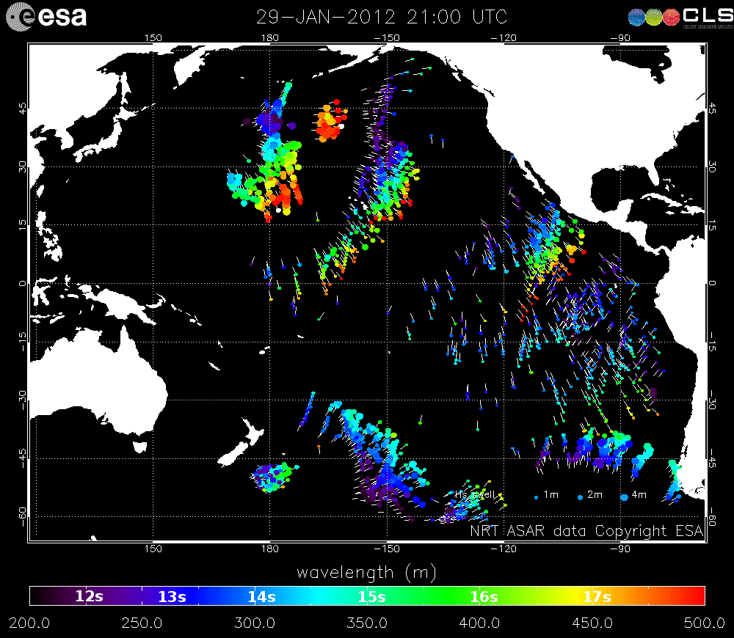
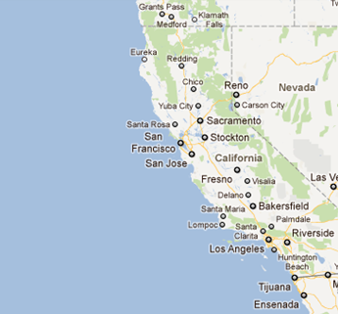
Background: Wave systems
Tracking of ASAR swell in the Pacific
NWS coastal forecast domains
http://www.esa.int/esaEO/SEM563AATME_index_0.html

Slide 4
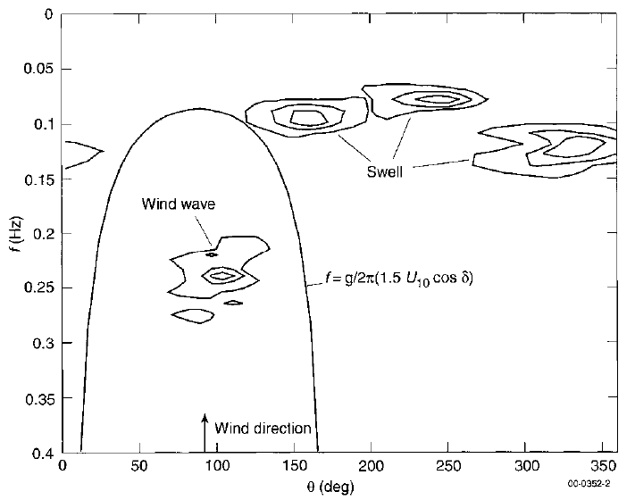
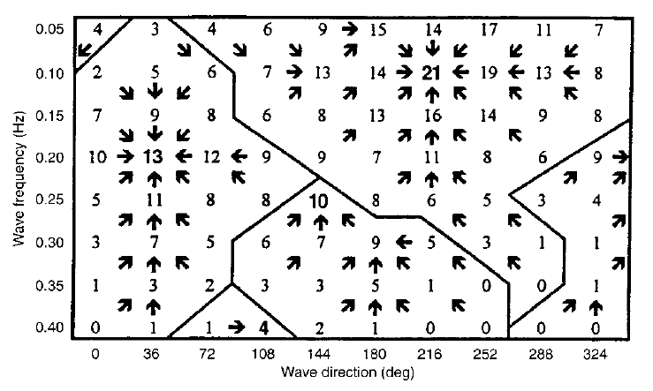
Partitioning of spectral model output
Partitioning of wave spectra
- Gerling (1992)
- Hasselmann et al. (1994, 1996)
- Hanson & Phillips (2001)
- Portilla et al. (2009)
(Tracy et al. 2007)
(Hanson & Phillips 2001)
(Hanson & Phillips 2001)

Slide 5
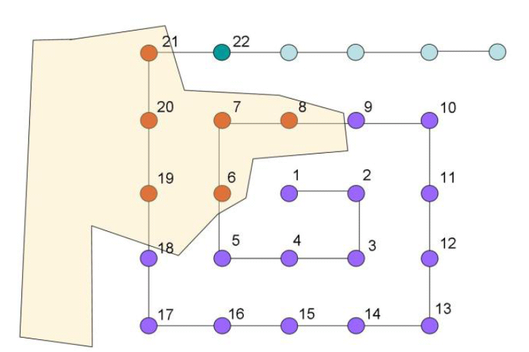
Tracking of spectral model output
Land
Sea
(Tracy et al. 2007)
(Devaliere et al. 2009)
Correlation of partitions in space and time:
- Continuity of parameters (Voorrips et al. 1997; Hanson & Phillips 2001; Devaliere et al. 2009)
- Source identification (Aarnes & Krogstad 2001; Delpey et al. 2010)

Slide 6
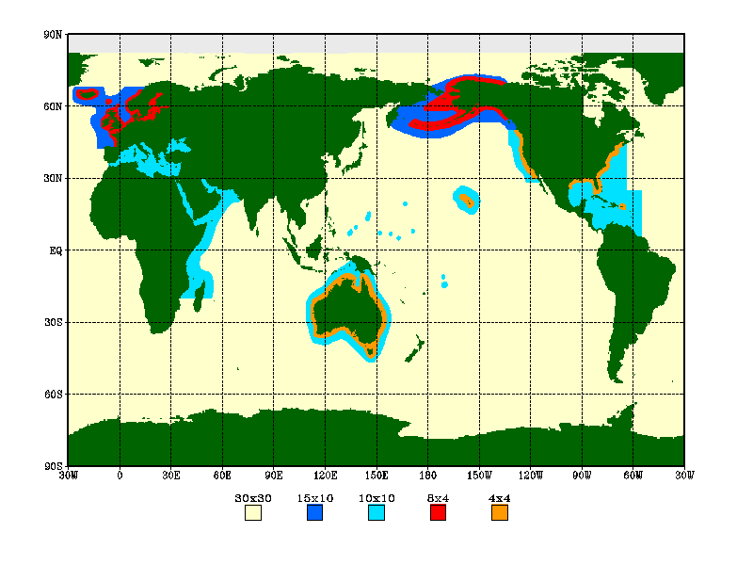

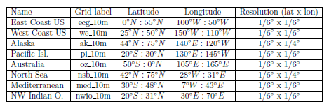
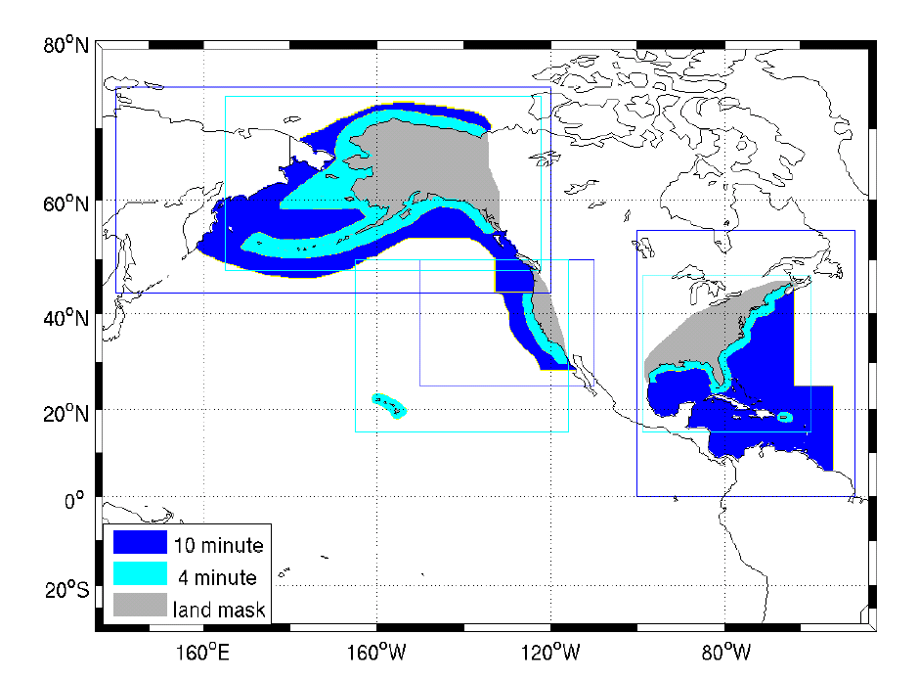
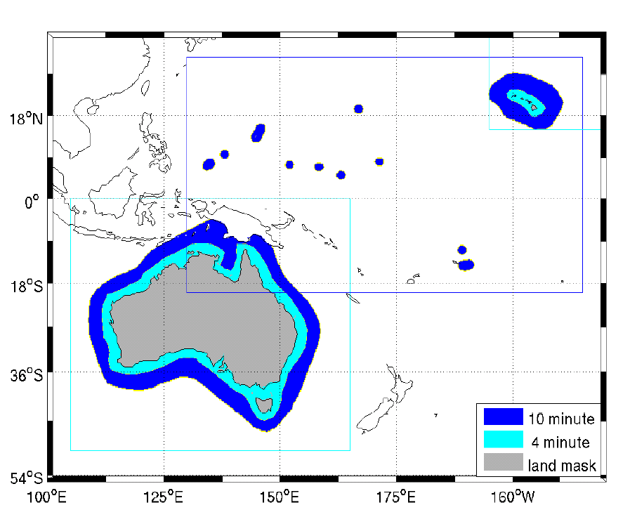
30-yr WW3 hindcast based on CFSR winds
(Chawla et al. 2013)

Slide 7
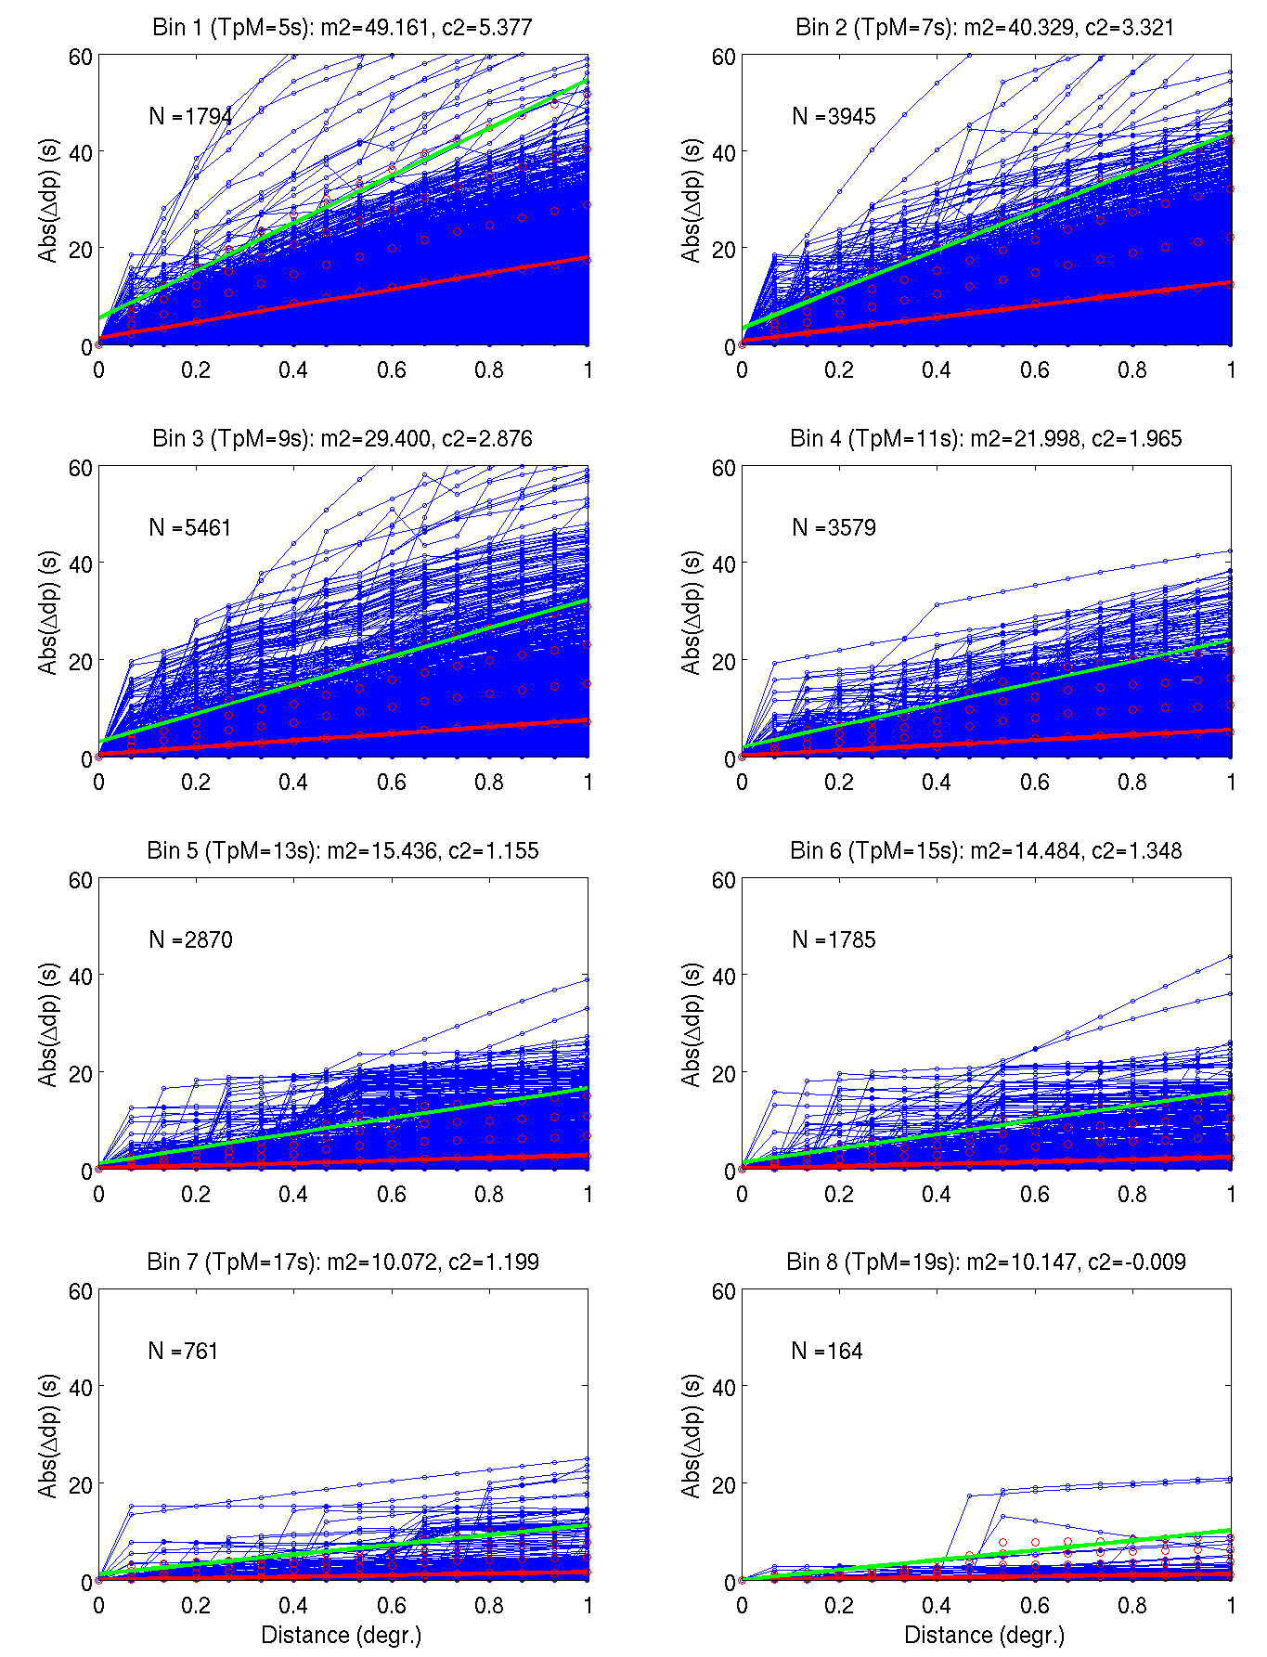
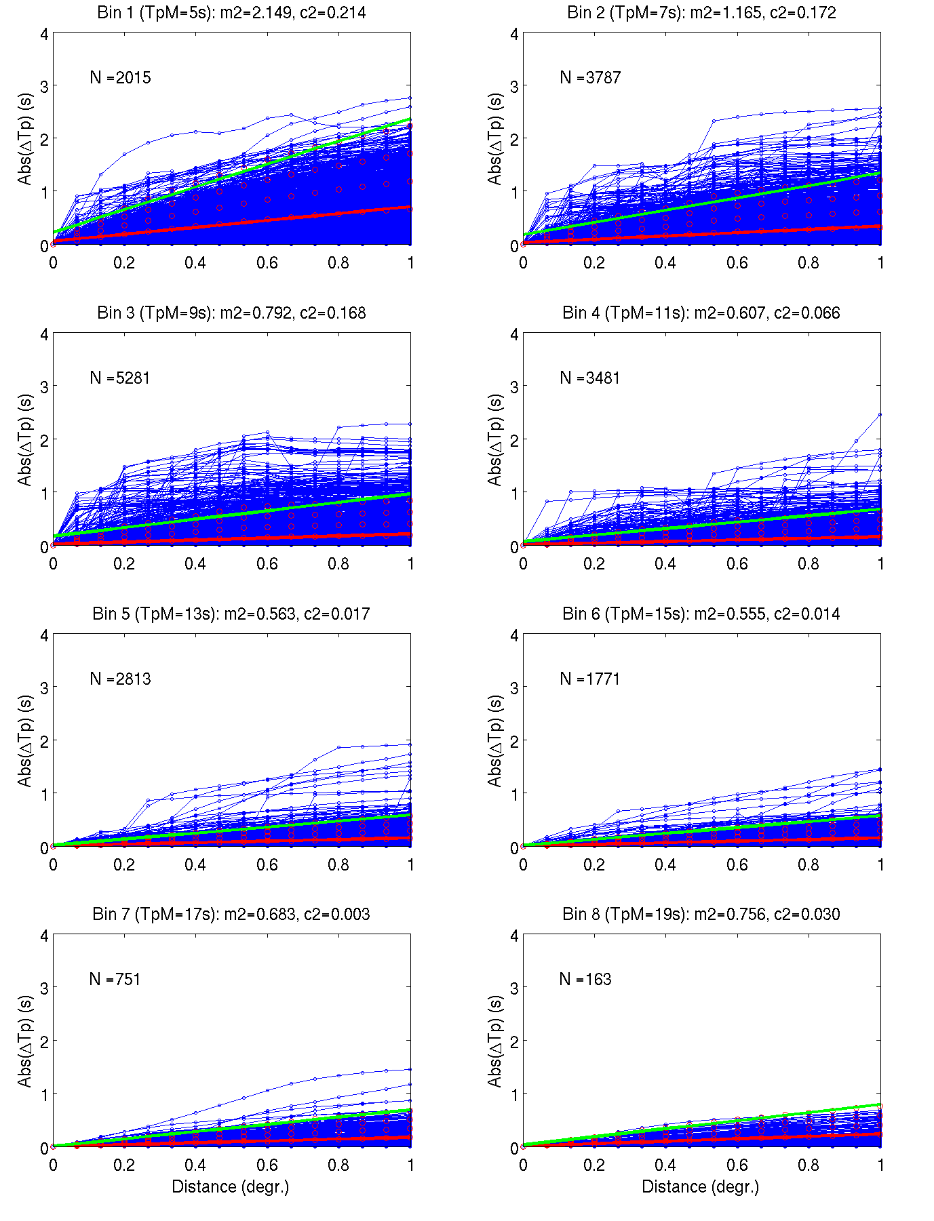
Spatial variation of DIR_{p} and T_{p}
CFSRR-WW3 4 arc-min, 3h hindcast, over 2007-2008
NDBC 46213, 46047, 41012, 41014
Dir_{p}
T_{p}
5s
7s
5s
7s
9s
11s
9s
11s
13s
15s
13s
15s
17s
19s
17s
19s

Slide 8
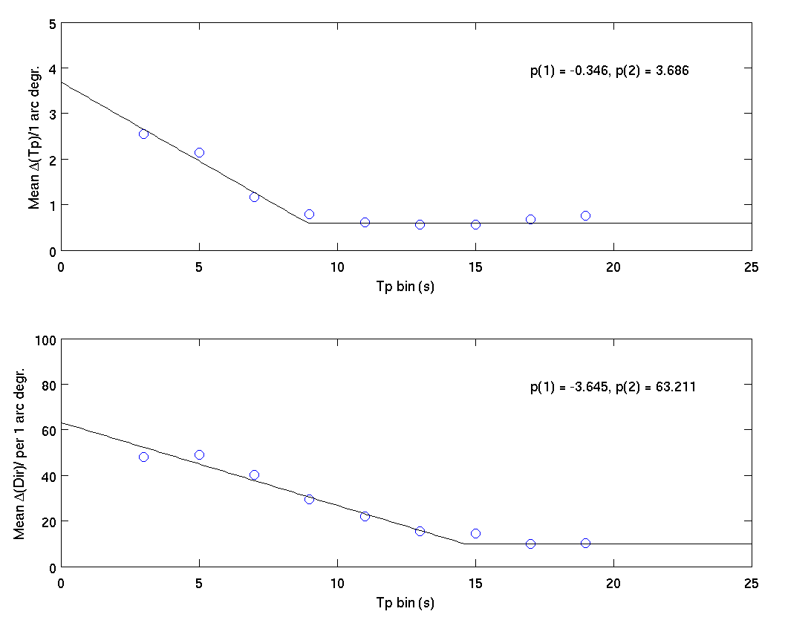
Criteria for spatial tracking
No neighbors!
Loop 1: Linking points to systems:
where:
and: δ_{θ} = 10º, δ_{T} = 1
Loop 2: Combining systems:
Combine if system neighbors differ by
less than ΔT_{n} and Δθ_{n}, with Δx = 1 arc-deg
Land
Sea
ΔT_{p}/1 arc-deg.
Δθ_{p}/1 arc-deg.

Slide 9
3 Criteria for temporal tracking
1) Mean period over system
Setting: δ_{T} = 1 s
2) Mean direction over system
Setting: δ_{θ} = 10º
3) Spatial overlap of systems:
Sys_{t-1,j}
Sys_{t,i}

Slide 10

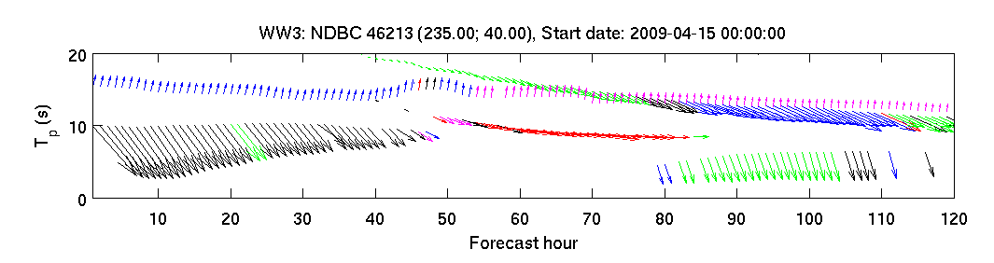
Program flow
ww3_systrk (main program)
waveTracking (read spectral partition input)
spiralTrack
Parallel region
t=1
t=2
t=3
t=n
timeTracking

Slide 11
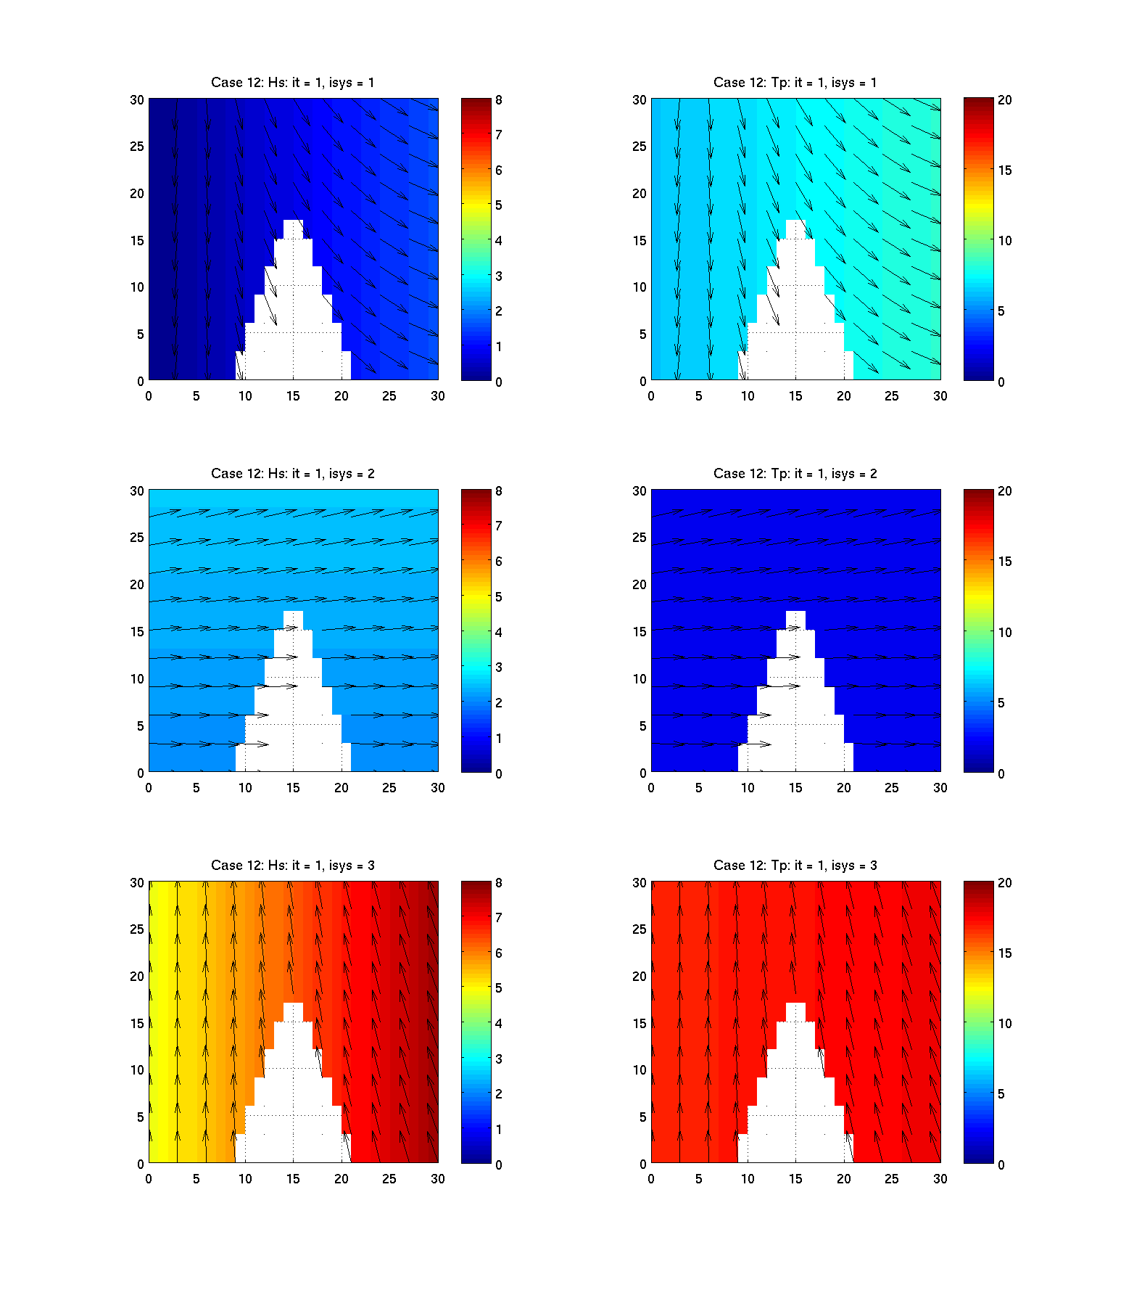
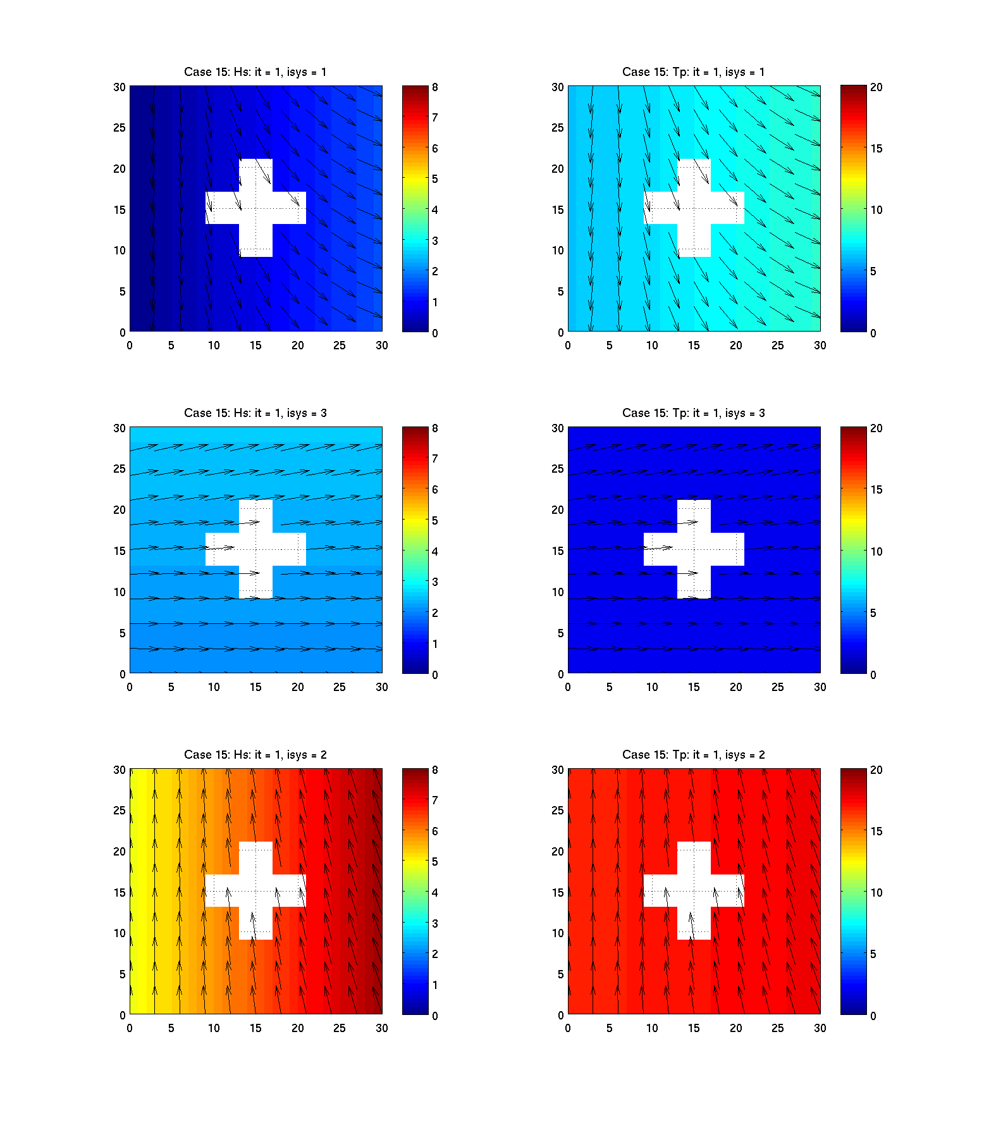
Idealized cases (wedge, “plus” island)
Sys1
Sys2
Sys3
Hs
T_{p}
Hs
T_{p}

Slide 12
30-yr WW3 hindcast based on CFSR winds

Slide 13
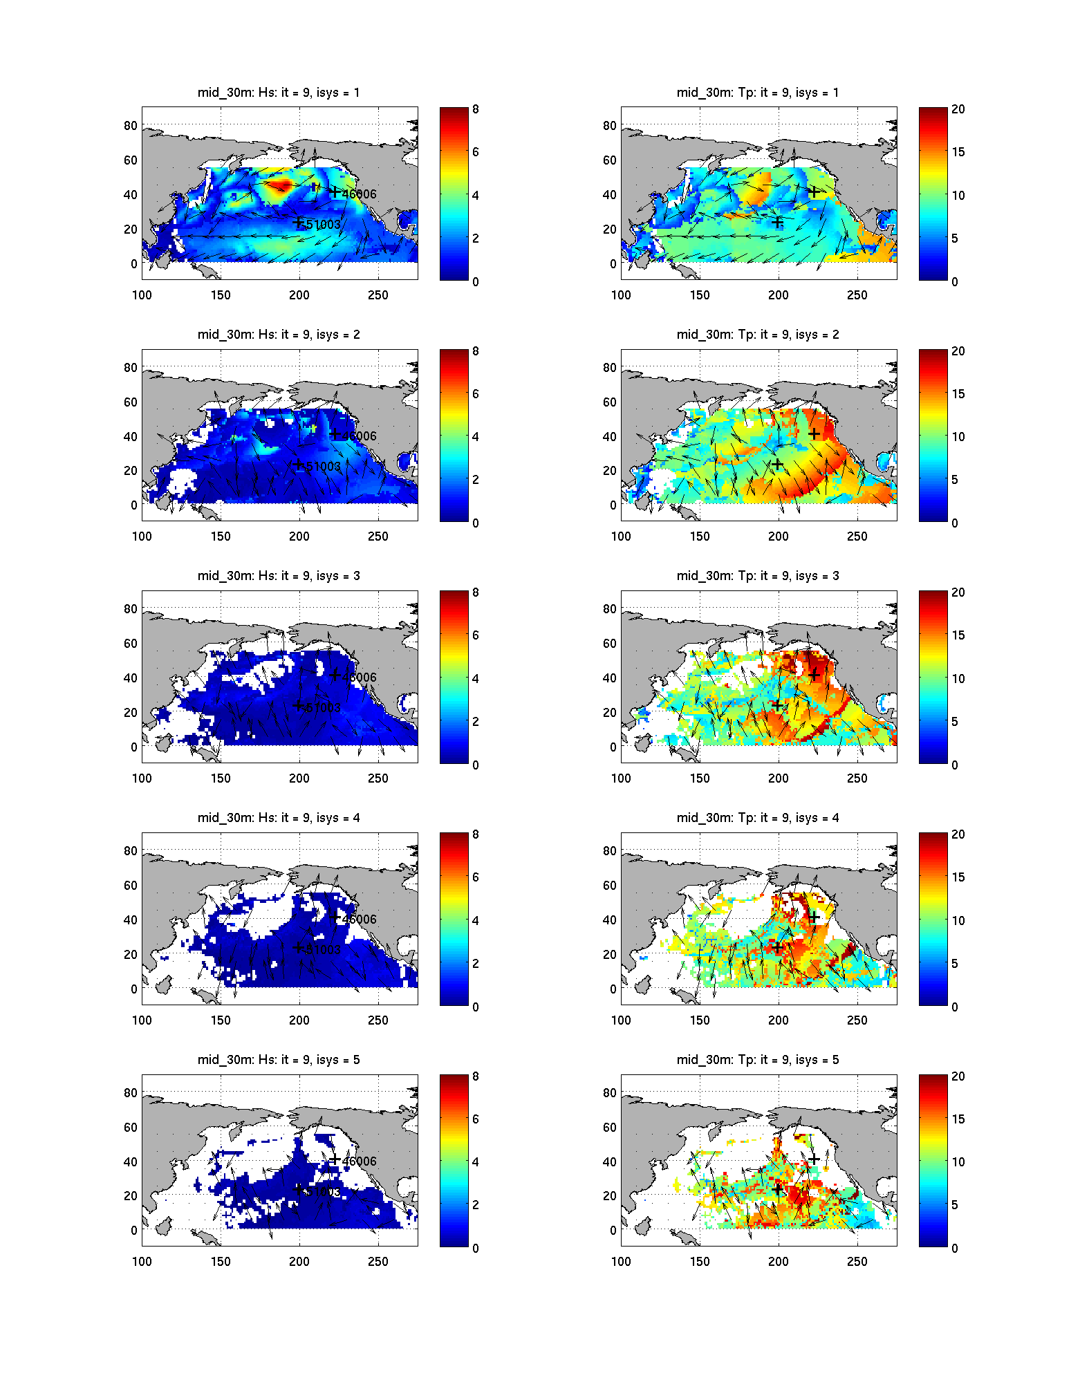
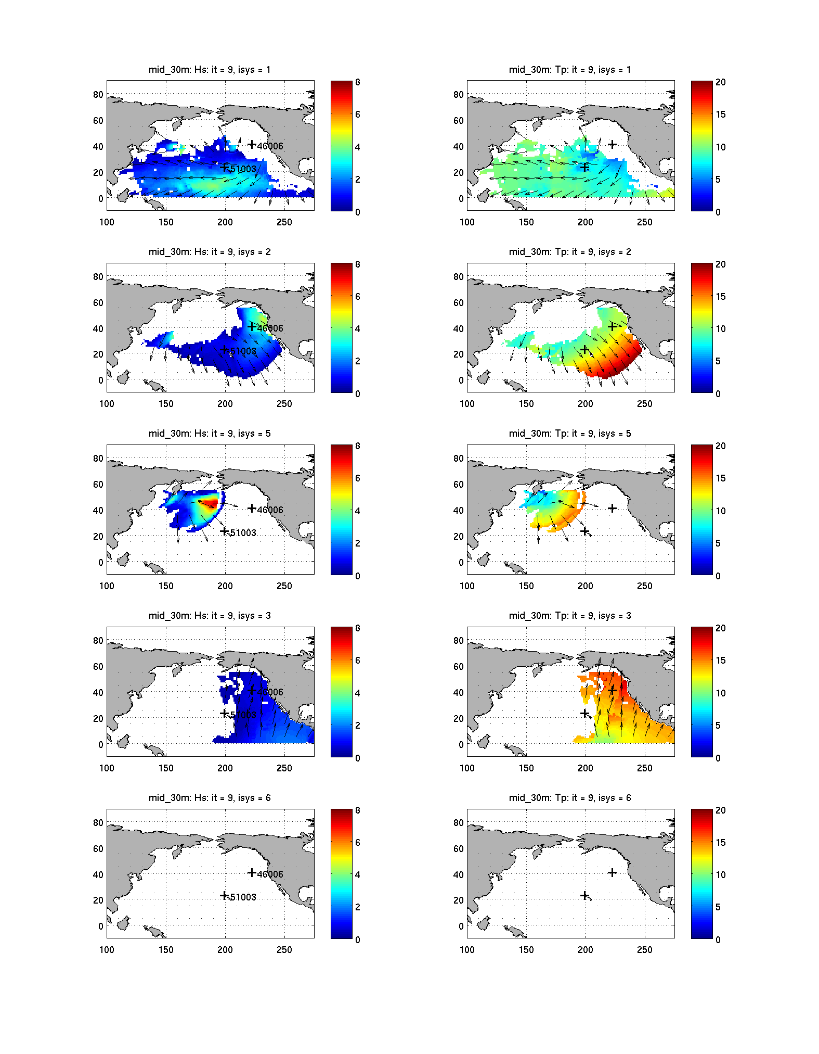
North Pacific, 30 arc-min grid
14 April 2009, 10:00
Raw partitioned data
Spatially tracked systems
Hs
Tp
Hs
Tp

Slide 14
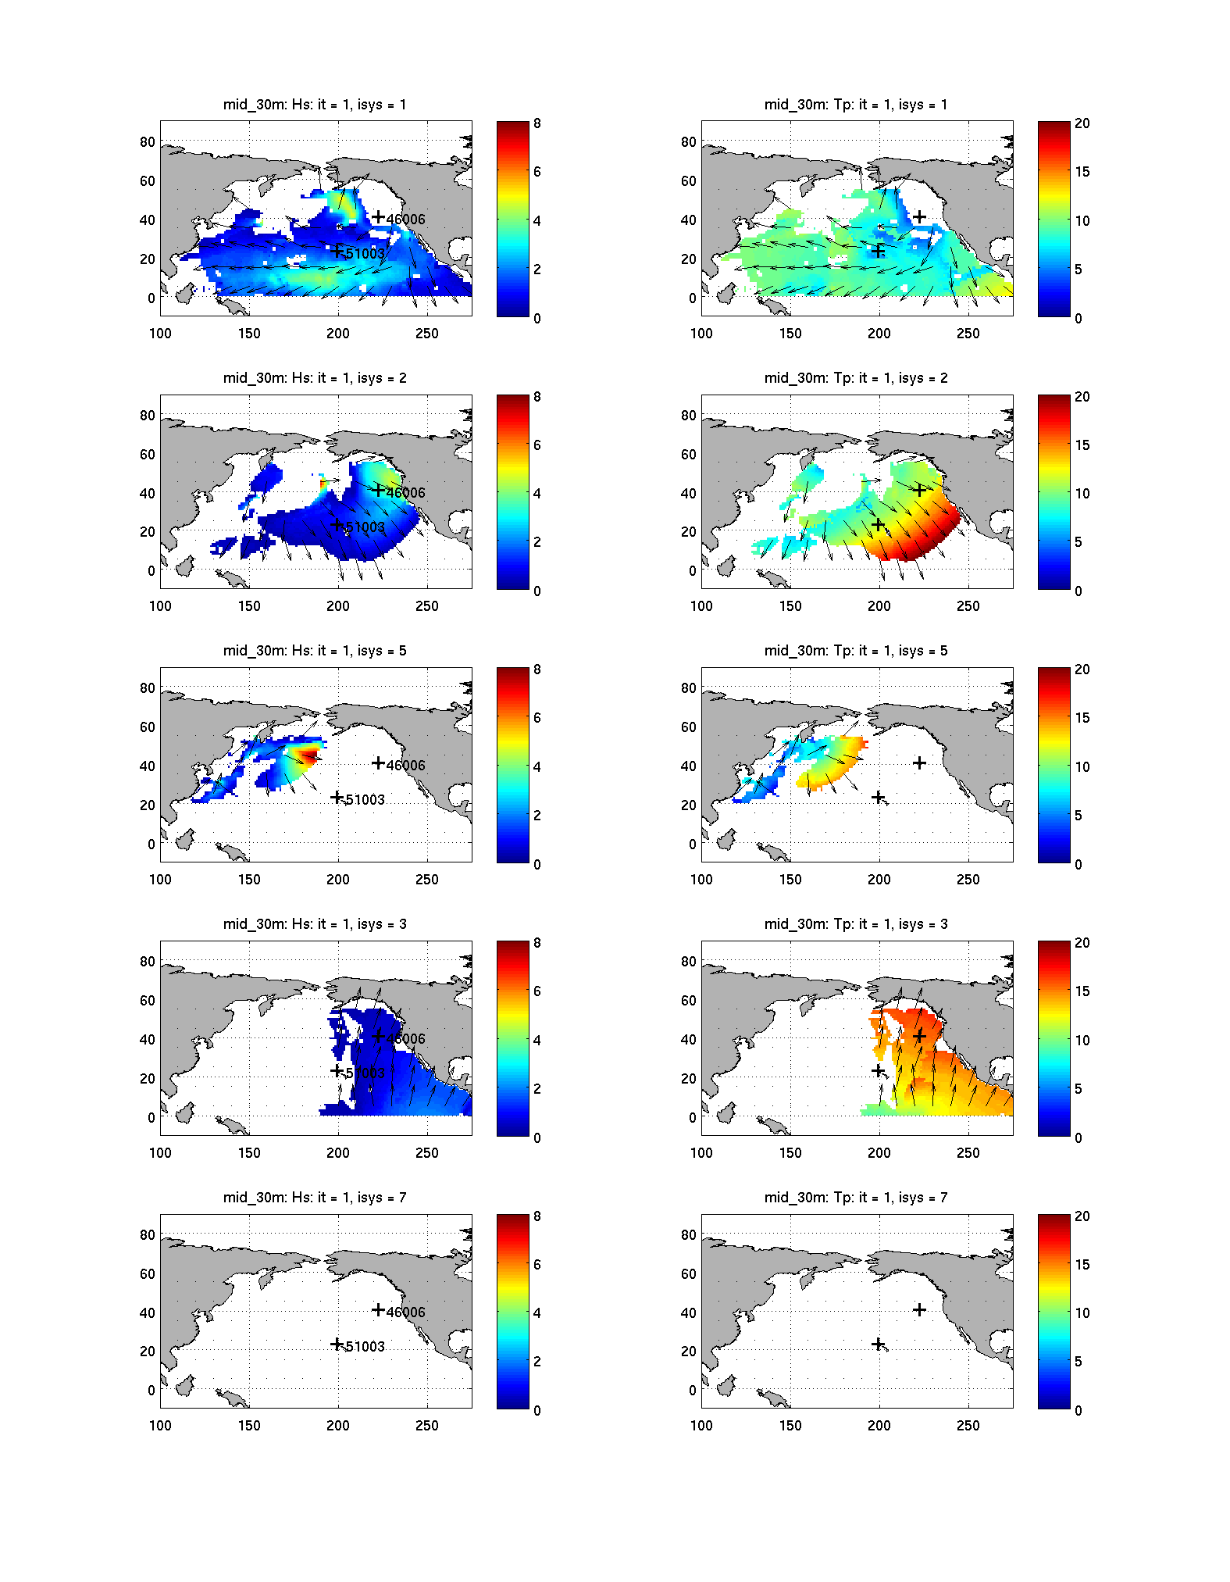
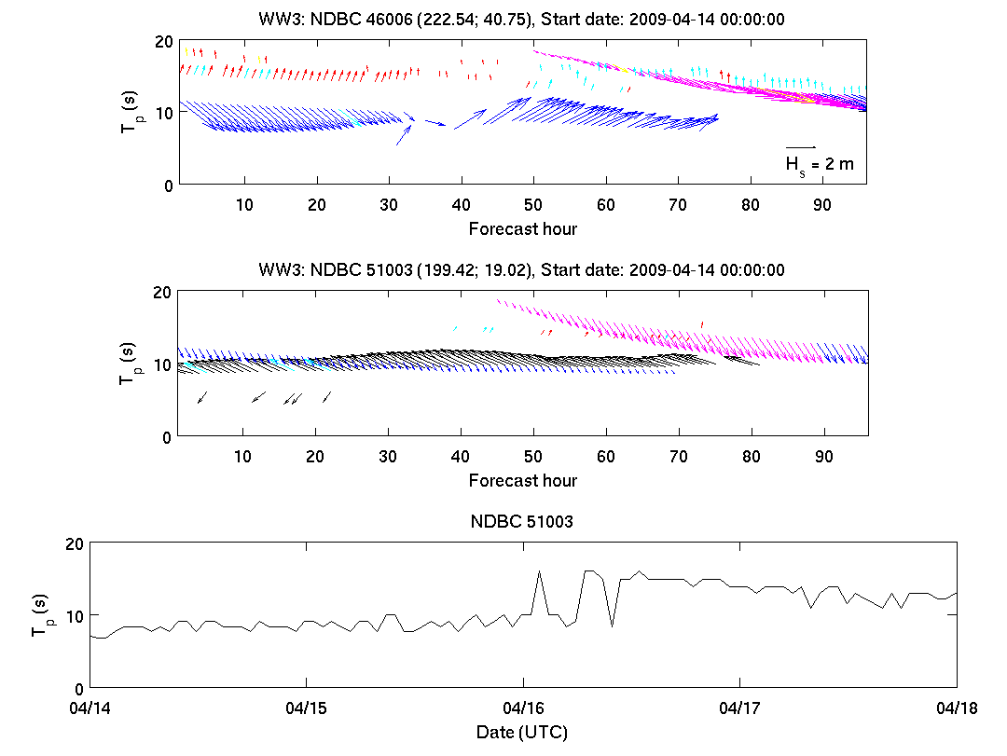
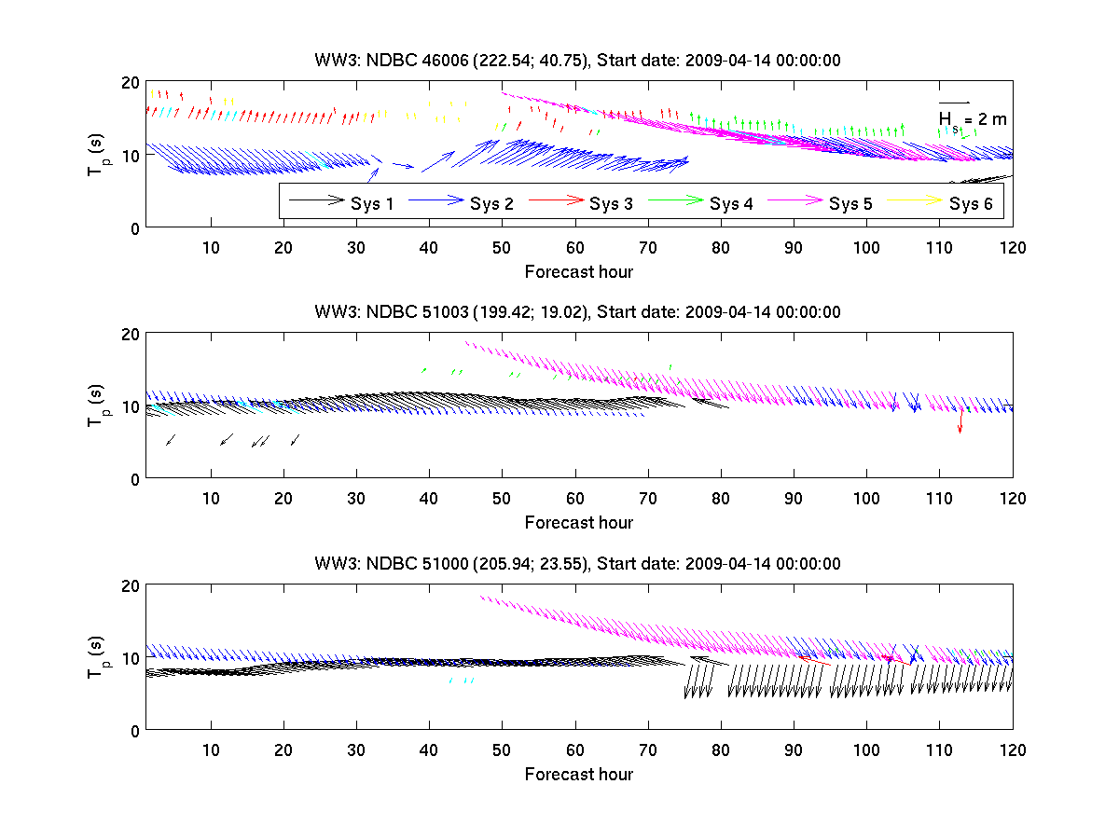
North Pacific,
30 arc-min grid
14 -18 April 2009

Slide 15
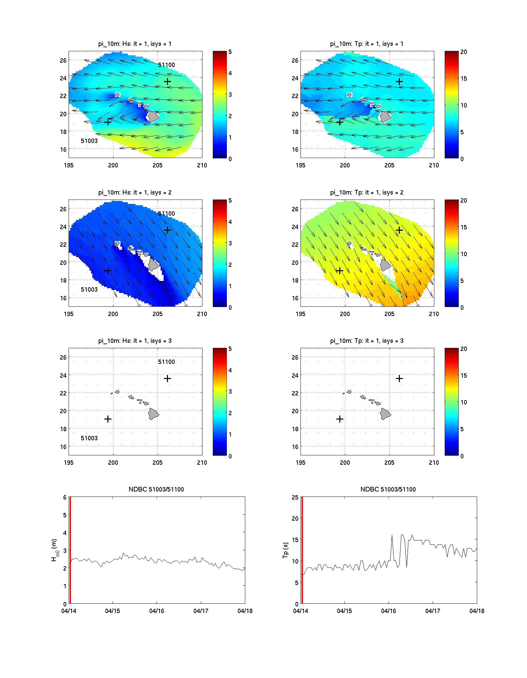
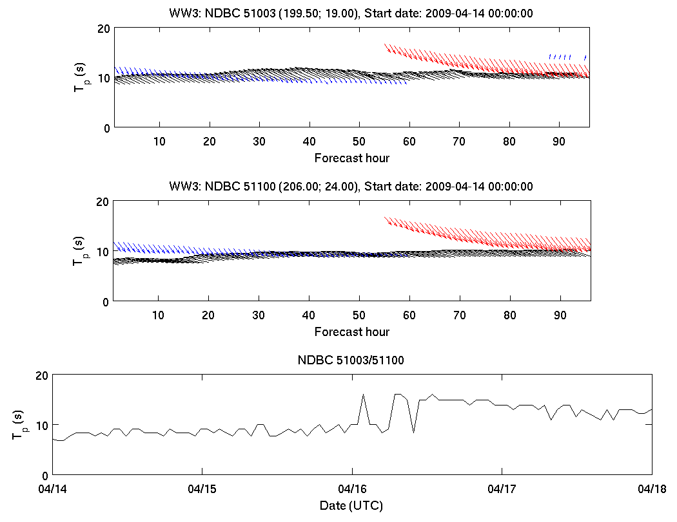
Hawaiian Islands, 10 arc-min grid
14 -18 April 2009

Slide 16
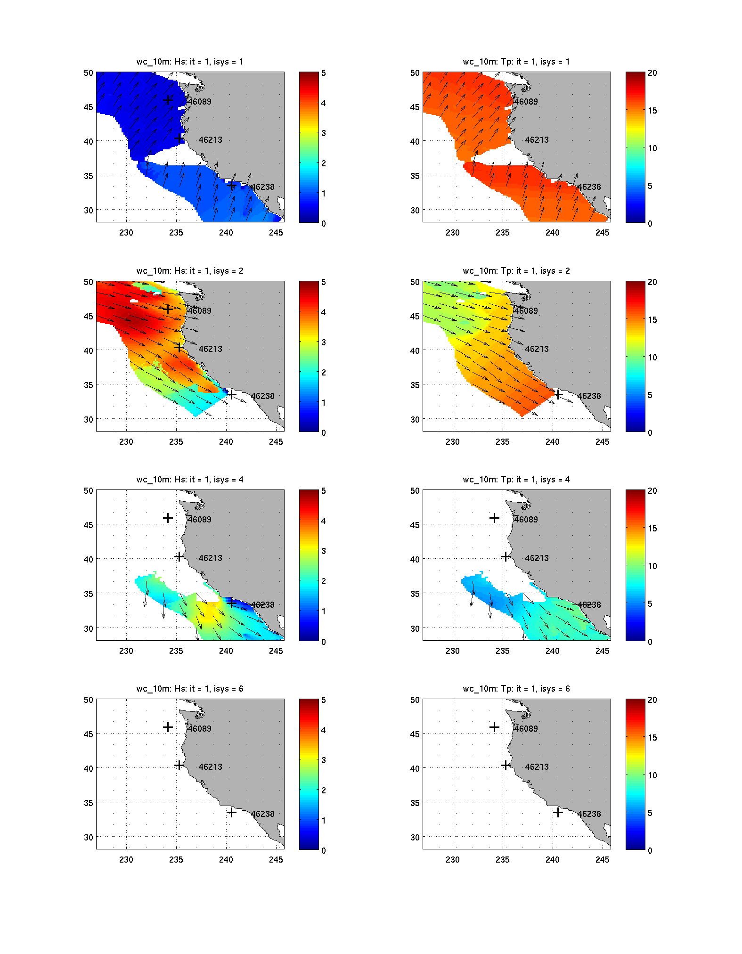
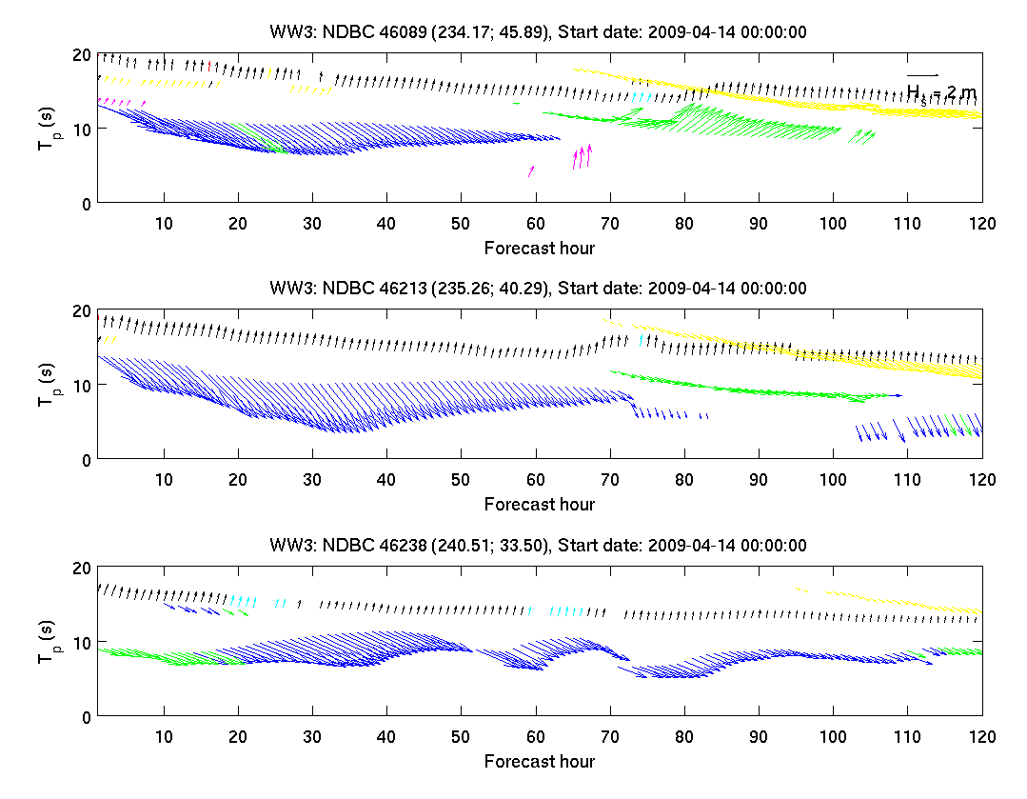
U.S. West Coast, 10 arc-min grid
14 -19 April 2009

Slide 17
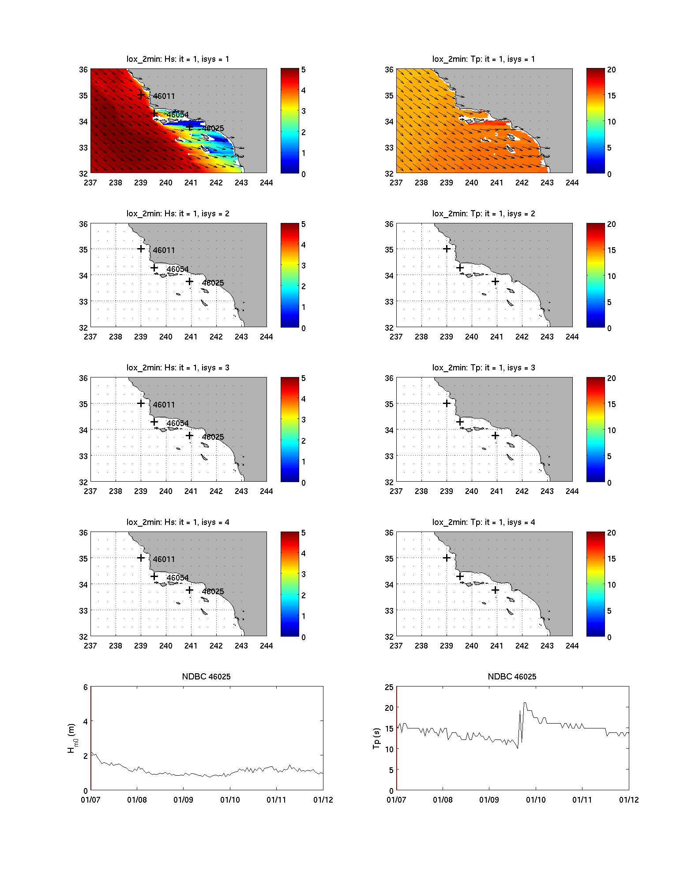
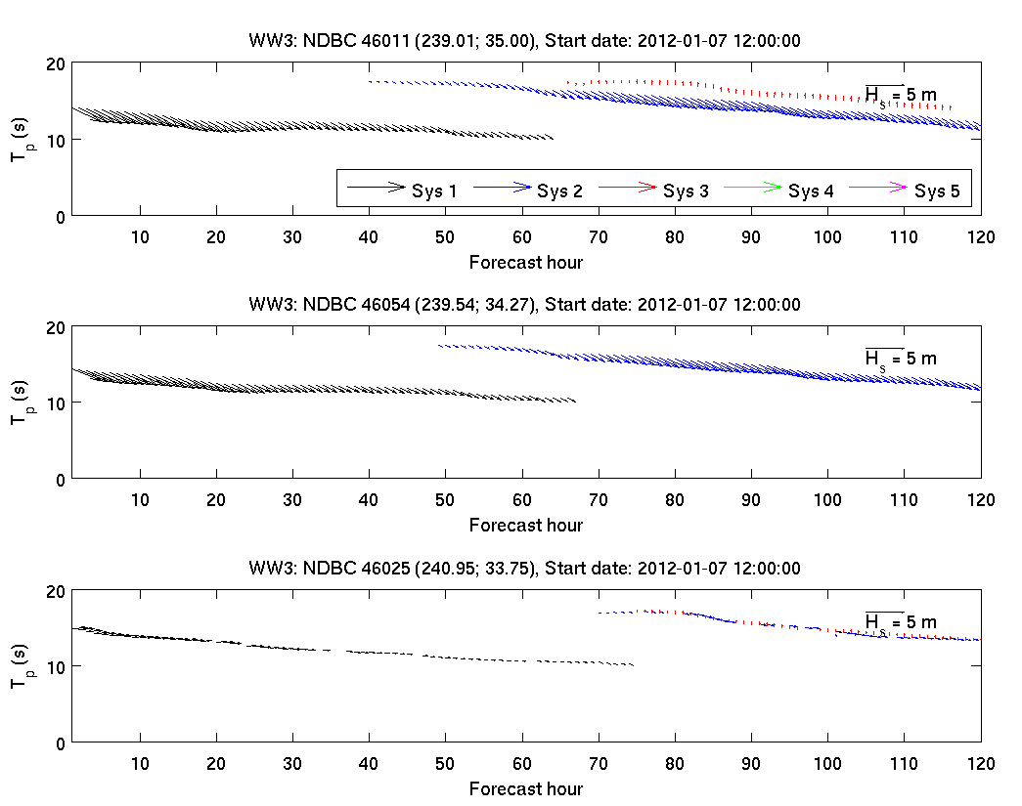
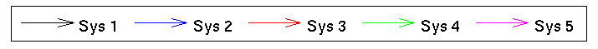
WFO Oxnard,
2 arc-min grid
7-12 Jan 2012

Slide 18
Conclusions & Future work
Spatial and temporal tracking post-processing available as WW3 subprogram ww3_systrk (see Van der Westhuysen et al. 2013).
Spatial variation of T_{p} and Dir_{p} determined from 2 years of CFSRR-WW3 wave climate data.
Verified for idealized cases and field cases at various scales (30-yr CFSRR-WW3 wave climate, WFO domains).
Future: Depth dependence in shallow water?
Future: Extension to unstructured grids

Slide 19
References
Aarnes, J.E, and H.E. Krogstad, 2001. Partitioning sequences for the dissection of directional ocean wave spectra: A review, technical report, SINTEF Appl. Math., Oslo.
Chawla, A., D.M. Spindler, H.L. Tolman, 2013. Validation of a thirty year wave hindcast using the Climate Forecast System Reanalysis Winds. Ocean Modelling, in press.
Delpey, M.T., F. Ardhuin, F. Collard and B. Chapron, 2010. Space-time structure of long ocean swell fields. J. Geophys. Res. 115, C12037, doi:10.1029/2009JC005885.
Devaliere, E.-M, J.L Hanson and R.A. Luettich, Jr., 2009. Spatial tracking of numerical wave model output using a spiral tracking search algorithm, Proc. 2009 WRI World Congress on Computer Science and Information Engineering, Los Angeles, CA, Vol. 2, 404–408.
Gerling, T.W., 1992. Partitioning sequences and arrays of directional ocean wave spectra into component wave systems. J. Atmos. Oceanic Technol., 9, 444–458.
Hasselmann, S., K. Hasselmann, and C. Bruning, 1994. Extraction of wave spectra from SAR image spectra. Dynamics and Modelling of Ocean Waves, G. J. Komen et al., Eds., Cambridge University Press, 391–401.
Hasselmann, S., C. Bruning, and K. Hasselmann, 1996. An improved algorithm for the retrieval of ocean wave spectra from synthetic aperture radar image spectra, J. Geophys. Res., 101, 16,615–16,629.
Hanson, J.L. and O.M. Phillips, 2001. Automated analysis of ocean surface directional wave spectra. J. Atmos. and Ocean Tech., Vol. 18, 277–293.
Portilla, J., F. J. Ocampo-Torres and J. Monbaliu, 2009. Spectral partitioning and identification of wind sea and swell, J. Atmos. and Ocean Tech., Vol. 26, 107–122.
Tracy, B, E.-M. Devaliere, J.L. Hanson, T. Nicolini and H.L. Tolman, 2007. Wind sea and swell delineation for numerical wave modeling, Proc. 10th Int. Workshop on Wave Hindcasting and Forecasting, Paper P12.
Voorrips, A.C., V.K. Makin, and S. Hasselmann, 1997. Assimilation of wave spectra from pitch-and-roll buoys in a North Sea wave model. J. Geophys. Res. 102, 5829–5849.
Van der Westhuysen, A.J., J. Hanson and E.-M. Devaliere, 2013. Spatial and temporal tracking of wave fields from ocean basin scales to coastal waters. J. Atmos. Oceanic Technol., in review.

