Slide 1



Time stepping
Hendrik Tolman
The WAVEWATCH III Team + friends
Marine Modeling and Analysis Branch
NOAA / NWS / NCEP / EMC
NCEP.list.WAVEWATCH@NOAA.gov
NCEP.list.waves@NOAA.gov

Slide 2
Outline
Covered in this lecture:
  Basic time steps per grid.
    Time steps versus limiter.
  Mosaic model runs.
    General grid interactions.
    Overlapping grids.
  Impact of output.

Slide 3
Basic time stepping
There are four basic time steps per grid:
  Overall time step to propagate solution.
  Time step for lowest model frequency in absence of currents to assure stable propagation (CFL).
  Refraction time step.
  Minimum source term time step.
  This is the order in the input file,
  But CFL is most important, and therefore discussed first.
  Qualitative here only, practical examples are all over the test cases provided with the model.

Slide 4
Basic time stepping
CFL time step:
  Only explicit FD propagation schemes are available.
    CFL criterion means that information can only be propagated by discrete number of grid boxes per time step.
      Depends on propagation scheme.
      All schemes available now allow one grid box.
    Violate it and the model will blow up (eventually).
  In the code:
    CFL time step adjusted as a function of frequency (longer time steps for higher frequencies).
    CFL time step dynamically adjusted for current velocity:
      Should stay stable, but
      Strong currents may slow down model.

Slide 5
Basic time stepping
Overall time step:
  The model allows for larger overall time steps, to acknowledge that the lowest frequency rarely contains information.
  Accuracy requires relatively small factor between CFL time step and overall time step (say 2~3).
    Do not want to propagation information over barely resolved bathymetry in overall time step.
  Ratio of overall / CFL time step directs needed overlap between equally ranked grids (more on day 2).

Slide 6
Basic time stepping
Refraction time step:
  “Refraction” includes great-circle direction change, depth and current refraction, and current induced wavenumber shifts.
  Refraction due to depth and current is filtered to assure stable solutions with large local depth changes.
    Filter per frequency.
    Fraction of CFL can be set by user.
  Reducing refraction time step will reduce use of filter.
    May be useful for pre-implementation testing of models.
  Generally kept large, but best set at half the overall time step, to avoid numerical wiggles due to alternate orders of computation.

Slide 7
Basic time stepping
Minimum source term time step.
History:
  WAM model used “limiter” to curtail the source term change of the spectrum per time step to assure integration stability for large source term time step.
  This has an impact on the solution, as will be shown below.
  WAM went to non-convergent limiter:
    Minimal impact of time step on solution, but
    Limiter becomes part of solution.
      OK for engineering application.
      Not good for research, since impact of limiter cannot be split from explicit physics.
  SWAN also uses limiters in iterations.

Slide 8
Basic time stepping
More history (details in manual):
  WAVEWATCH II (not III !):
    Use limiter to dynamically adjust time step to get accurate yet economical source term integration.
      Compare to parametric change.
      Compare to (filtered) relative change.
      Do not apply in tail.
      Apply limiter if computed time step is less to allowed minimum time step.
    Need to know something about limiters as they still are used depending on setup of model.
  Smaller minimum time step results in smoother model, often in faster model.
    I generally use 5~60 s.
Tolman 1992: JPO., 22, 1095-1111.
Tolman 2002: GAOS, 8, 67-83.

Slide 9
Limiters
Simple WAM-3 time limited growth test.
  Old convergent limiter.
  Initial growth strongly influenced even for small Δt.
  Convergent solution reproduced by dynamic time step.
What about WAM-4 an SWAN approaches?
Good engineering, but good science?

Slide 10
Limiters
Asymmetric convergent limiter.
  All with Δt = 1200s
  Convergent, thus reduction in Δt get to true solution.
  Time step dep. remains for initial growth.
Feasibility study in Tolman (2002) only.
Might be useful for WAM or SWAN,

Slide 11
Limiters
f_{p}
(Hz)
H_{s} (m)
More accurate H_{s} with larger error in f_{p}.
I fear this is symptomatic for limiters.

Slide 12
Mosaic models
Some multi-grid time step basics:
  In a multi-grid model the time stepping for grid is set up individually per grid.
  Two examples are given in the following slides.
    Triple nest for swell propagation.
    Triple nest for hurricane.
  You do not have to coordinate time steps per grid, but if you do not, you may have a problem predicting how this works.

Slide 13
Swell propagation
Boundary data grid with 1-D propagation.
Outer grid with full propagation but constant depth and no currents.
Inner grid with output locations.
Alternative inner grid with depth and current.
1-D propagation only

Slide 14
Swell propagation
Boundary and outer grid share time step.
Boundary grid does not receive data back from outer grid.
Inner grid at half the time step of the outer grid.
Fully automated data flow / time stepping.
time
set global synchronization time
run model
run model with boundary data
average from inner to outer
start over
bound
outer
inner
run model
bound. data
global sync.
averaging

Slide 15
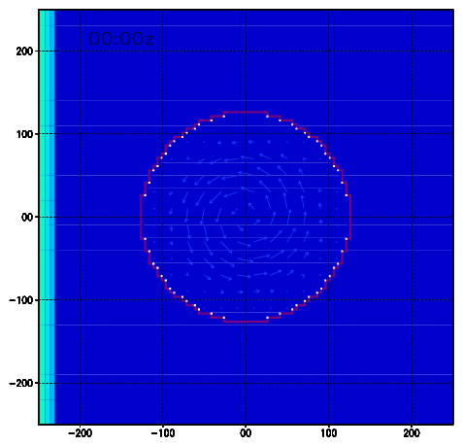
Swell propagation
Current ring with circular inner domain. Input wave height is 2.50m, contours at 0.20m, including 2.40 and 2.60. Third order UQ scheme.
One-way nesting
Two-way nesting
Movie loop.

Slide 16
Hurricane
Hurricane described with Rankin vortex with maximum wind of 45 m/s at radius of 50km. Stationary hurricane or continuously moving grids.
Telescoping grids with 50, 15 and 5 km resolution.
Alternative circular domains.

Slide 17
Hurricane
Factor 3 in time steps between grids.
Full communication between grids
Fully automated data flow / time stepping.
set global synchronization time
run model
run model with boundary data
average
time
run model with boundary data (3x)
50 km
15 km
5 km
run model
bound. data
global sync.
averaging

Slide 18
Hurricane
Hurricane moving to the right at 5m/s with circular domains and Tolman and Alves (2005) moving grid approach.
composite of grids
multi-grid model
Tolman and Alves, 2005: Ocean Modelling, 9, 305-323.

Slide 19
Output
This was all about running the model,
But if you want output too …..
  The model is always providing data at all times for which output is requested.
    Overrides overall time step in ww3_shel as needed.
    Ditto impact in ww3_multi.
Pitfall:
  In example input files a single restart file is asked for at a single time.
    Interval is set at 1 second.
    Some folks changed the interval without changing the increment ……

Slide 20
The end
End of lecture

