Slide 1
Regression testing
W. Erick Rogers
Oceanography Division
Naval Research Laboratory
Stennis Space Center, MS
The WAVEWATCH III Team + friends
Marine Modeling and Analysis Branch
NOAA / NWS / NCEP / EMC
NCEP.list.WAVEWATCH@NOAA.gov
NCEP.list.waves@NOAA.gov

Slide 2
Outline
Covered in this lecture:
additional documentation
naming convention for regression tests
run_test script
compilers and MPI
bugs and broken things

Slide 3
Documents
Additional documentation
WAVEWATCH III® development best practices
NCEP website (v3.14): http://polar.ncep.noaa.gov/waves/wavewatch/wavewatch.shtml#documentation
In repository (v4, restricted access): {branch or trunk}/guide/report.pdf
run_test wikis (restricted access):
https://svnemc.ncep.noaa.gov/trac/ww3/wiki/NrlTest
https://www7320.nrlssc.navy.mil/Alvin/index.php/WW3_Test_Cases

Slide 4
Test names
Naming conventions for test cases:
ww3_tp1N: Tests for one-dimensional propagation
ww3_tp2N: Tests for two-dimensional propagation
ww3_tp3N: Tests for two-dimensional propagation in unstructured grids
ww3_tsN: Tests of source terms
ww3_tpsN: “realistic” tests with both propagation and source terms
mww3_testN: simple tests for multi-grid wave model
mww3_caseN: “realistic” tests for multi-grid wave model

Slide 5
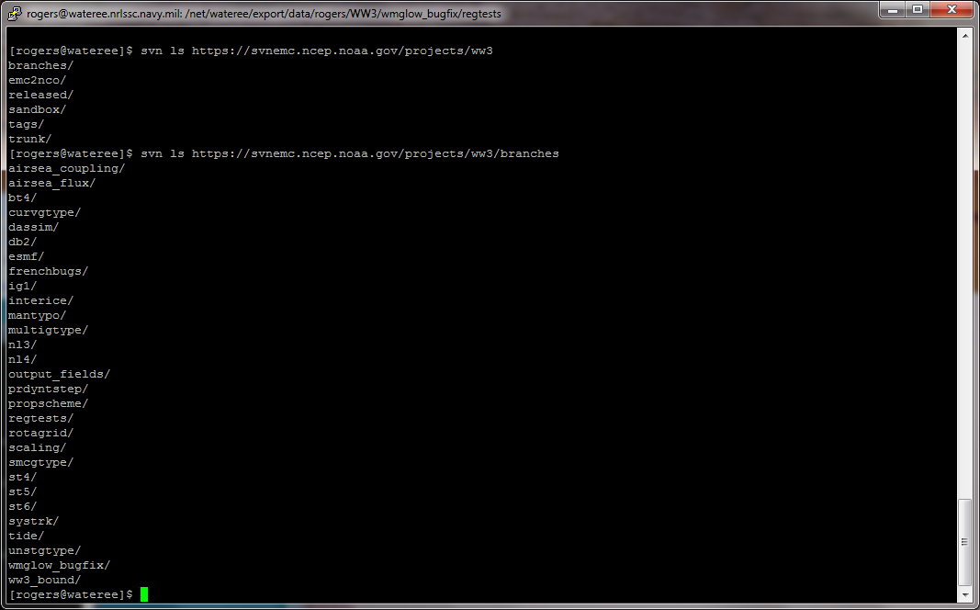
svn
Note added by Erick Feb 12 2013 (after class ended) : Some content on this slide is not legible via projector. Prior to use in a subsequent class, the “screen grabs” should be converted to larger font powerpoint text boxes.
NCEP svn server

Slide 6
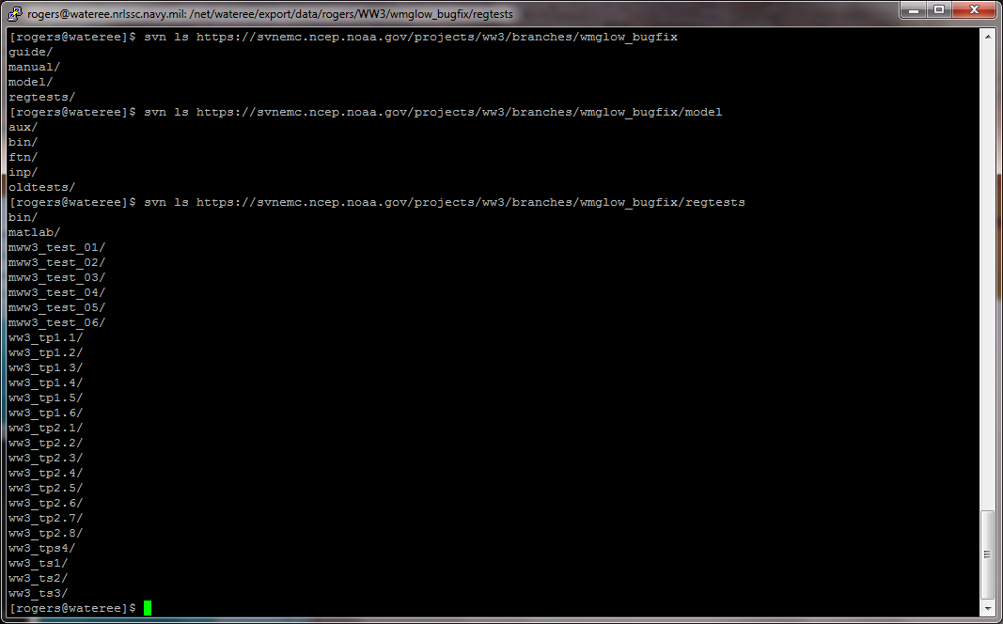
/regtests/
Note added by Erick Feb 12 2013 (after class ended) : Some content on this slide is not legible via projector. Prior to use in a subsequent class, the “screen grabs” should be converted to larger font powerpoint text boxes.
regtests on NCEP svn server

Slide 7
run_test
run_test script introduction:
shell script: ./regtests/bin/run_test
diff_ww3, run_suite, cleanup, run_cmp provided in same directory: not covered here, but may also be useful
each major test case occupies a directory, e.g. ./regtests/ww3_tp1.1/
sub-types are available via multiple “run-time selectable” variants of switch, ww3_multi.inp, and ww3_grid.inp in ./regtests/{test name}/input/
additional sub-types can be created by individual users
“run-time selectable” variants of ww3_shel.inp, ww3_strt.inp, ww3_trck.inp, ww3_bound.inp are not supported (yet), but users may customize them and/or use cp or ln to select variants
multiple variants of ww3_outf.inp, ww3_ounf.inp, ww3_outp.inp, ww3_ounp.inp, ww3_prep.inp exist. These are not “run-time selectable”: all existing variants are executed with every run.
If you have added a feature, you must also add a regression test (or sub-test) which utilizes your new feature

Slide 8
run_test
run_test script execution:
execute without arguments (or with –h argument) for screen dump re: usage
-c : change compiler (required on first use)
-g : select a non-default grid (single grid cases)
-i : select a non-default directory for input files
-s : select a non-default switch file
-w : use a non-default work directory
-m : select grid set (multi-grid cases)
-r : run only one program (e.g. ww3_prep)
-q : quit after running program (e.g. ww3_grid)
-n and –p : instructions for parallel runs
-a and –e : select or modify wwatch3.env file
-o select standard or NetCDF output

Slide 9
run_test
run_test script execution:
running run_test for the first time in a “fresh” export/checkout of a branch:
wwatch3.env file will be created interactively*
“-c” must be used to set comp and link files*
most run_test arguments are optional (i.e. defaults exist)
exception: multi-grid case require “-m”
“-s” is needed if file with default name /{test name}/input/switch does not exist
example commands:
./bin/run_test -s ST1 ../model/ ww3_ts1
./bin/run_test -m grdset_a -n 3 -p mpirun -s PR3_MPI_SCRIP -w work_a_PR3_MPI_SCRIP ../model mww3_test_03
* if not done manually

Slide 10
testing
When to perform regression testing:
after major changes to your branch
thorough set of tests needed
prior to merge from your branch to trunk
thorough set of tests needed
after minor/incremental change to your branch
usually a single regression test is enough
Which regression tests to use:
Common sense applies. Examples:
if you are adding a new dissipation term, then you probably didn’t break the propagation (lower priority to test)
if you are modifying NL1 code, you should check impact on all source term packages (ST1, ST2, etc.) (higher priority to test)

Slide 11
evaluating
How to use results:
verify that test runs to completion
this is sufficient to catch most problems
however, if you have reason to worry (e.g. if you have made major changes)
run earlier version of code, and verify that differences are expected (non-graphical method: can use “diff” on the work directories), or
visualize results, or
both of the above

Slide 12
compilers and MPI
Compilers:
Developers should occasionally test with an alternate compiler
This is much more critical than you might expect.
Everyone should include gfortran in their testing (since it’s free, you don’t have a good excuse not to...)
MPI:
Developers should test with MPI prior to any merge to trunk
This can be done on a workstation
Rule applies even if your changes have no obvious connection with MPI
More machines, more compilers, more eyeballs ➔ more likely to find problems

Slide 13
bugs
Bugs and otherwise broken code
Find bugs early via run_test, ideally, before you commit to repository
bugs found late create version-control nightmares
If you find out too late that your code is broken:
halt all unrelated development in this branch until problem is fixed
if bug remains unresolved, you may want to back out the problem revision, or split off a new branch from a prior bug-free revision
Think ahead: If you have the (good) habit of checking in revisions in small increments, this will make it easier to find out when/where/why code became broken.
brute force method: combine “svn export” with “run_test” to identify revision

Slide 14
bugs
What to do if you think that the code is broken
If the problem is in your branch only
make sure that it doesn’t get merged to trunk
work with your branch’s dev team to fix it
If the problem is more general
Notify the “trunk authorities”. At time of writing, this is H. Alves. Do not complain to a 3rd party and expect him/her to notify the authorities.
Create/identify a test case that can be executed with run_test which exhibits the problem. If you created a new test case, check it into the repository. (In some cases, it may be best to create a new branch for this. There is also a “regtests” branch that can be used.)
Open a ticket (or help trunk authorities to do so). Include the run_test command in the ticket documentation.

Slide 15
The end
End of lecture

Slide 16
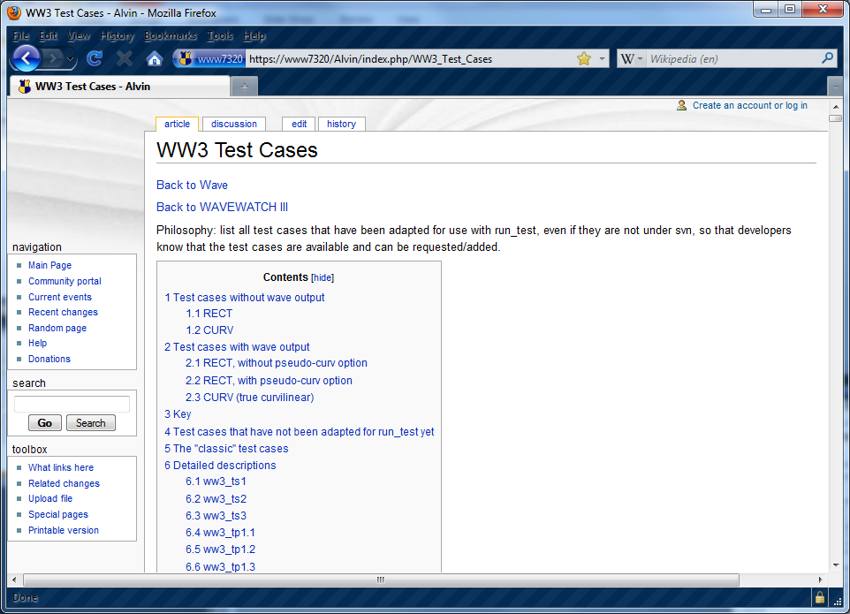
NRL wiki re: run_test cases

Slide 17
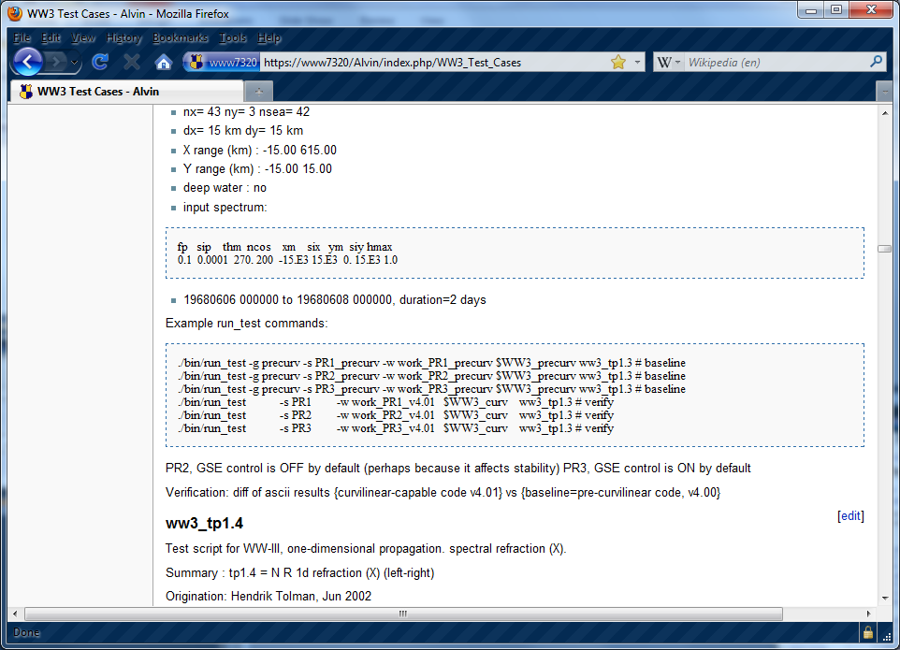
NRL wiki re: run_test cases

