Slide 1



Quasi-stationary WAVEWATCH III
André van der Westhuysen
The WAVEWATCH III Team + friends
Marine Modeling and Analysis Branch
NOAA / NWS / NCEP / EMC
NCEP.list.WAVEWATCH@NOAA.gov
NCEP.list.waves@NOAA.gov

Slide 2
Outline
Covered in this lecture:
  Action balance equation and solution methods
  Quasi-stationary operation of WWIII
  Alternative QS approaches
  Field case: Hurricane Gustav

Slide 3
Action balance equation
  Required physics for nearshore application already present
  Eulerian approach on rectangular, curvilinear or unstructured grids
  Explicit vs. Implicit implementations
  CFL constraints and nearshore application

Slide 4
Resolving coastal scales
Current WWIII model
grid mosaic
Desired nearshore application
Max. coastal resolution = 4 arc min (7.5 km)
Nearshore resolution: < 100 m

Slide 5
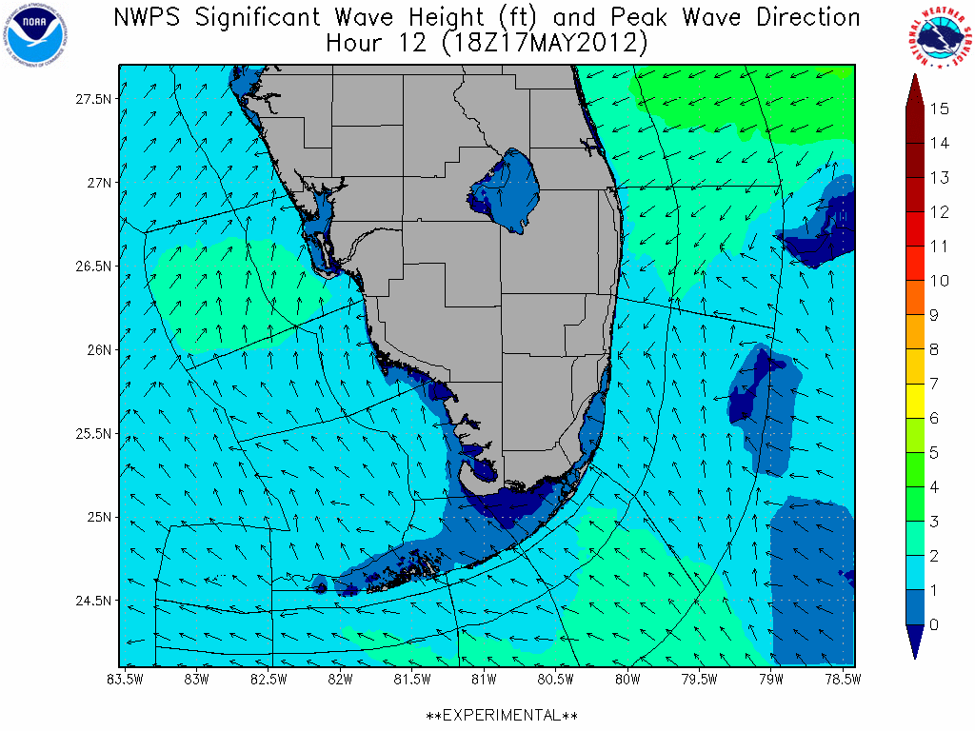
Performance comparison: Explicit vs. Implicit
WFO MFL Alpha testing site
1 arc-min grid
96 h forecast, dt – 600 s

Slide 6
Quasi-stationary operation of WWIII
Residence time
Global input/output interval
Quasi-stationary conditions
where:
Time stepping can be accelerated:
  where ,
  with α a constant = 1.2

Slide 7
Test case: Idealized wave propagation
f_{p} = 0.33 Hz, Std dev. = 0.01 Hz
Dir = 270 ºN, monochromatic, long-crested

Slide 8
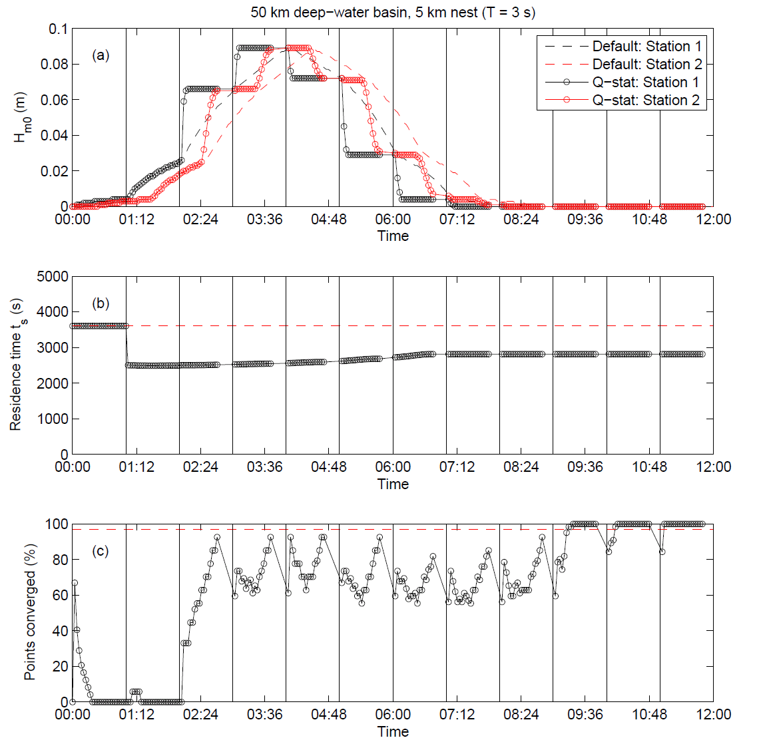
Approach 1: Discontinuous time stepping, discontinuous stationary BC

Slide 9
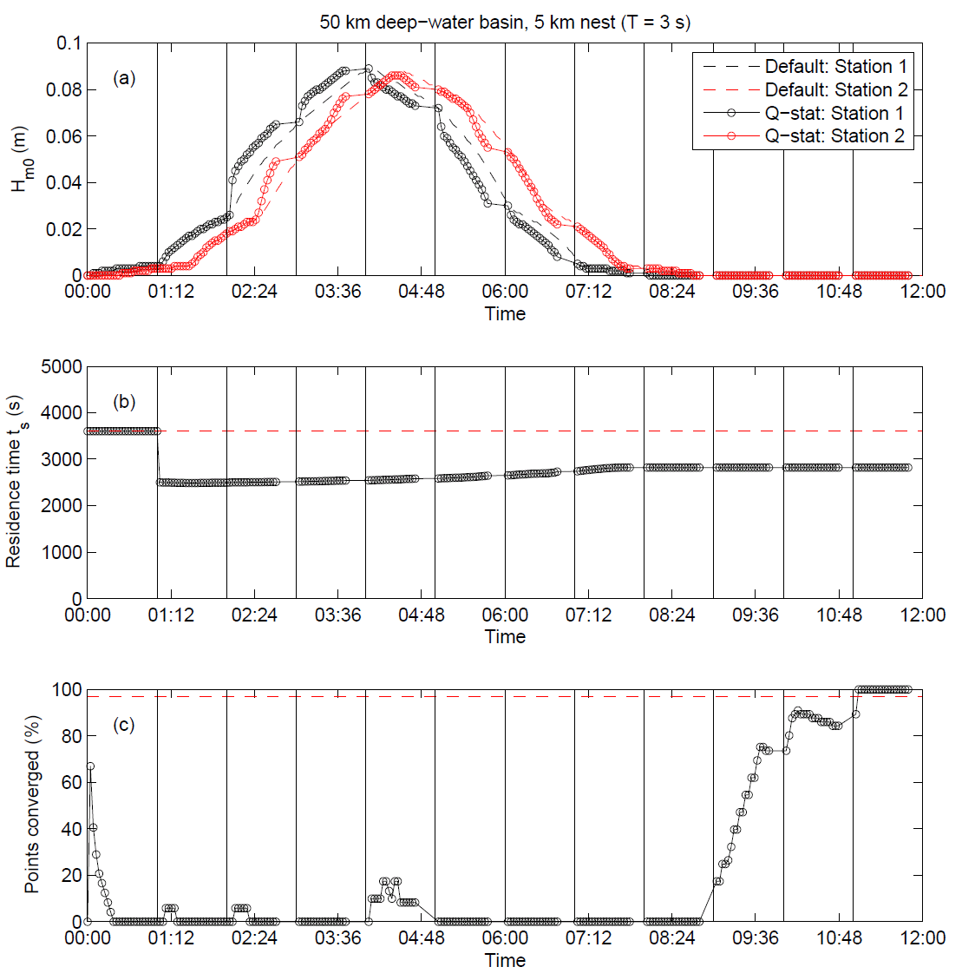
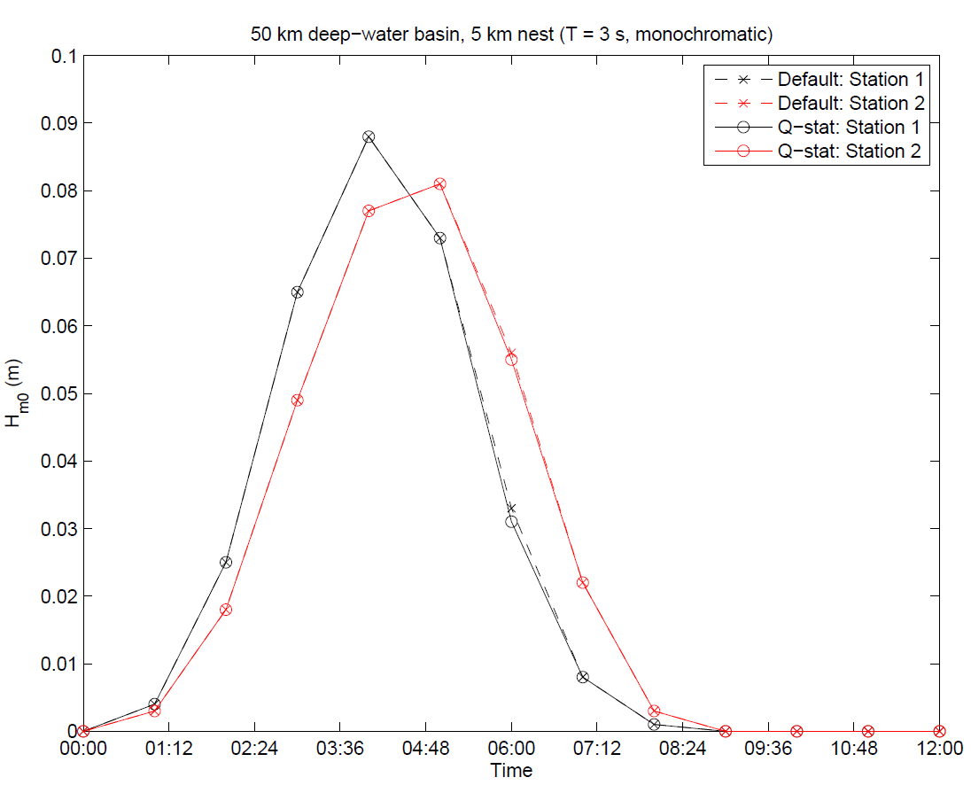
Approach 2: Discontinuous time stepping, discontinuous nonstationary, phase-shifted BC

Slide 10
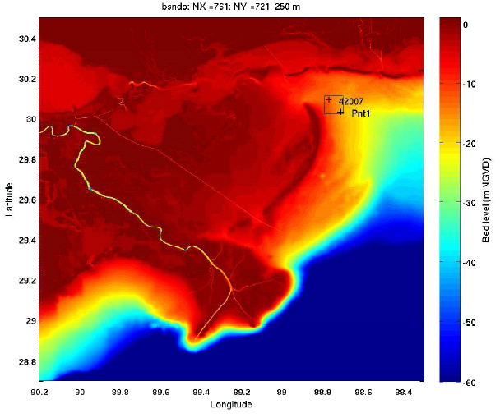
Field case: Hurricane Gustav (Aug-Sept 2008)
Data: Chen et al. (2010)

Slide 11
Results: H Gustav (Nonstationary WWIII)
Grid 1
Grid 2
Grid 3
Grid 4
Grid 5
Grid 5: Δt_{n} = 5 s
Run time = 67 min
(512 cores on IBM Power6 Cluster)

Slide 12
Results: Hurricane Gustav, QS WWIII

Slide 13
Results: Hurricane Gustav, QS WWIII
Wave-field dependent t_{s}
Constant t_{s} = 1800 s

Slide 14
Conclusions
  If the residence time t_{s} in nearshore domains is shorter than the input/output interval, quasi-stationary conditions develop, and a saving in computational time of the explicit model is possible.
  Quasi-stationary approach is proposed with (i) discontinuous time stepping, and (ii) nonstationary, discontinuous, phase-shifted BCs.
  With variable t_{s} computed from wave field: Local computational time savings of up to 50% (depending on domain and wave condition), with errors below 1% and no spurious phase lag.
  With constant t_{s}: Greater constant savings in computational time (50% total), but with greater error (H_{m0} < 5%; T_{m01} < 2%).
  Run time is about 20 times longer than an equivalent nonstationary SWAN run (with Δt = 10 min, no. iter = 3), but CFL condition is adhered to, and error can be controlled.
  Future: QS implementation for WWIII Multigrid.

Slide 15
The end
End of lecture

